Slide 1
Message Wall service
Juan-Luis Gorricho

Slide 2





Implementation
This is a first approach implementing a message wall service.
This approach focuses on defining interfaces and their implementations to manage the usual data of a message wall service: Message, MessageWall and UserAccess.
This approach follows the MVC pattern, but it doesn't consider any persistence.

Slide 3

Interfaces
public interface MessageWall {
void put(String user, String msg); boolean delete(String user, int index); Message getLast();
int getNumber();
List<Message> getAllMessages();
}
public interface Message { String getContent(); String getOwner();
}

Slide 4

Interfaces
public interface RemoteLogin {
UserAccess connect(String usr, String passwd);
}
public interface UserAccess { String getUser(); Message getLast();
int getNumber();
void put(String msg); boolean delete(int index);
List<Message> getAllMessages();
}

Slide 5
schema of classes
RemoteLogin (application scope)
Login.html
Controller Servlet
new
Any access
UserAccess (session scope)
MessageWall (application scope)
Servlet Container
Html reply
WallView Servlet

Slide 6

Packets
demo.spec:
  Message.java, MessageWall.java
  RemoteLogin.java, UserAccess.java
demo.impl:
  MessageWall_and_RemoteLogin_Impl.java
  Message_Impl.java, UserAccess_Impl.java
demo.web:
  ContextListener.java
  ControllerServlet.java
  WallViewServlet.java

Slide 7
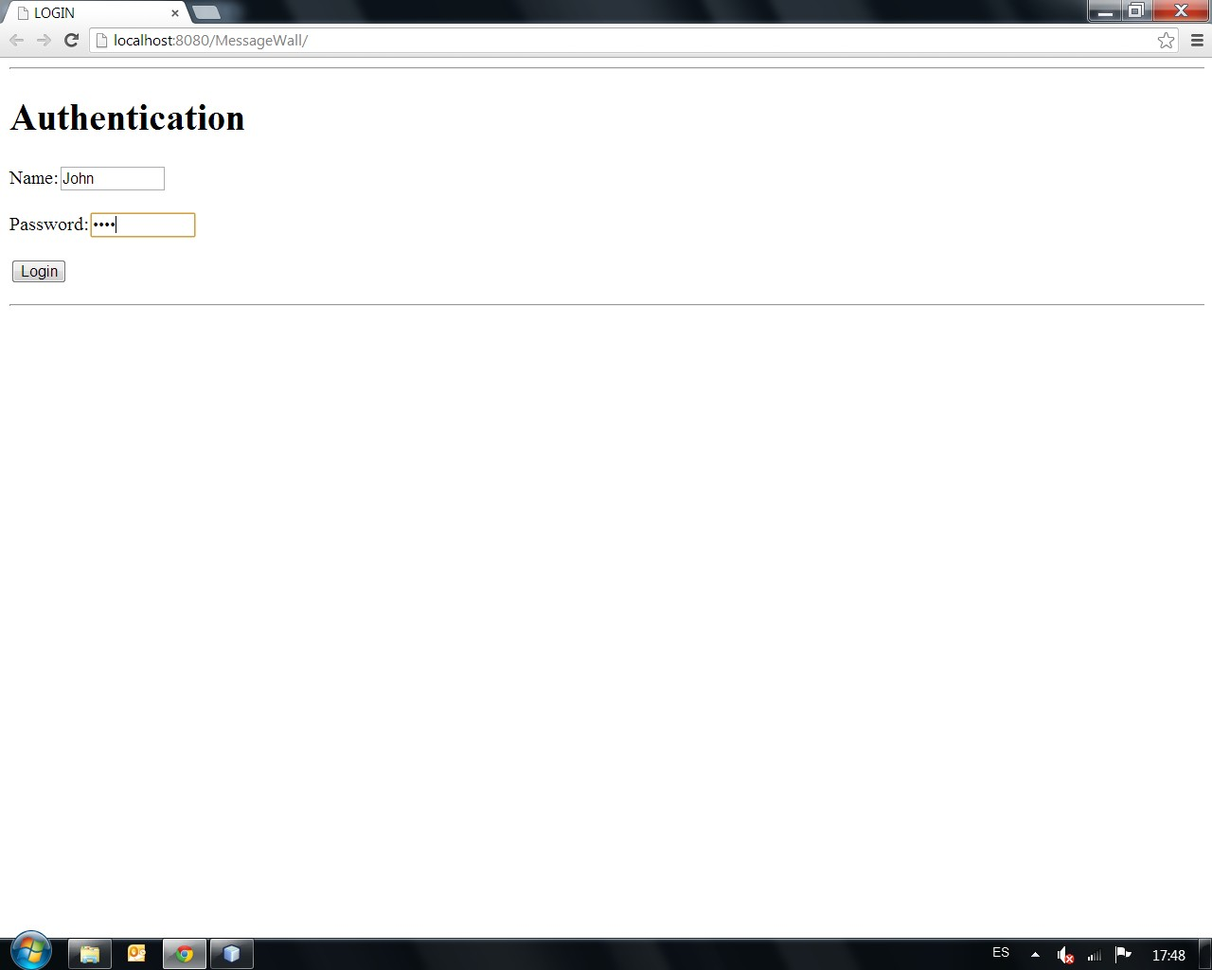
Login

Slide 8
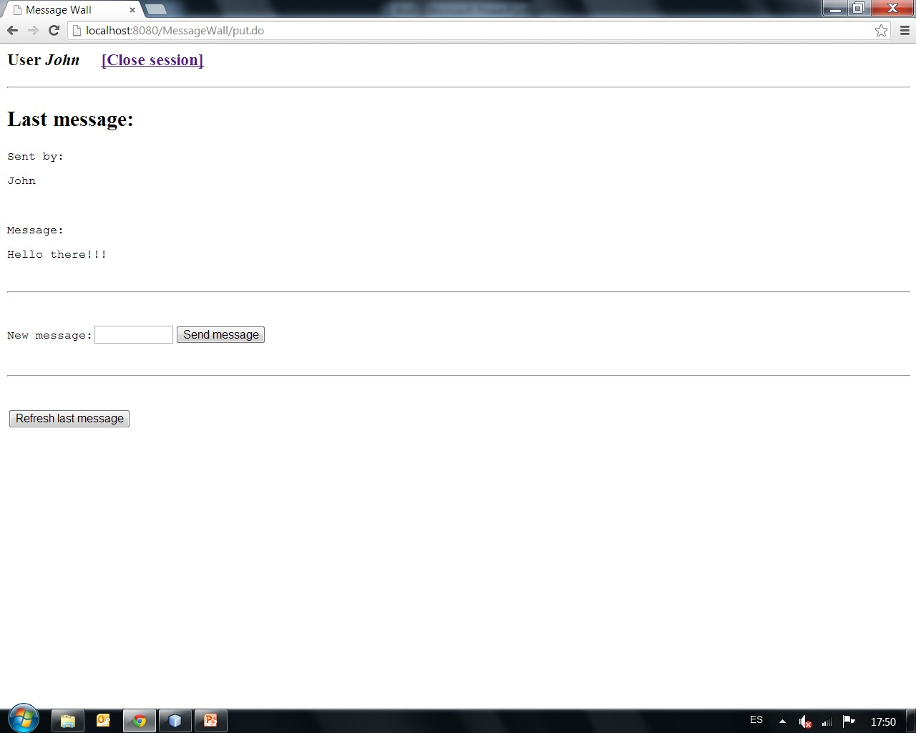
Wall view

Slide 9
1st Exercise
Review the initial content of the web application: MessageWall_exercise
Complete the code for the classes in package demo.impl and the java class: ControllerServlet
Hint: for the forward action made from the ControllerServlet, review the web.xml file as it specifies the servlet mapping when forwarding the request to a non-html file

Slide 10
2nd Exercise
Complete the code for wallview.jsp to show all messages posted on the wall at the same time, attach each message’s owner and the option to delete the message
Modify the ControllerServlet to show the new view instead of the old one
Add a minimal login functionality using a hash table with predefined pairs of user/password

Slide 11
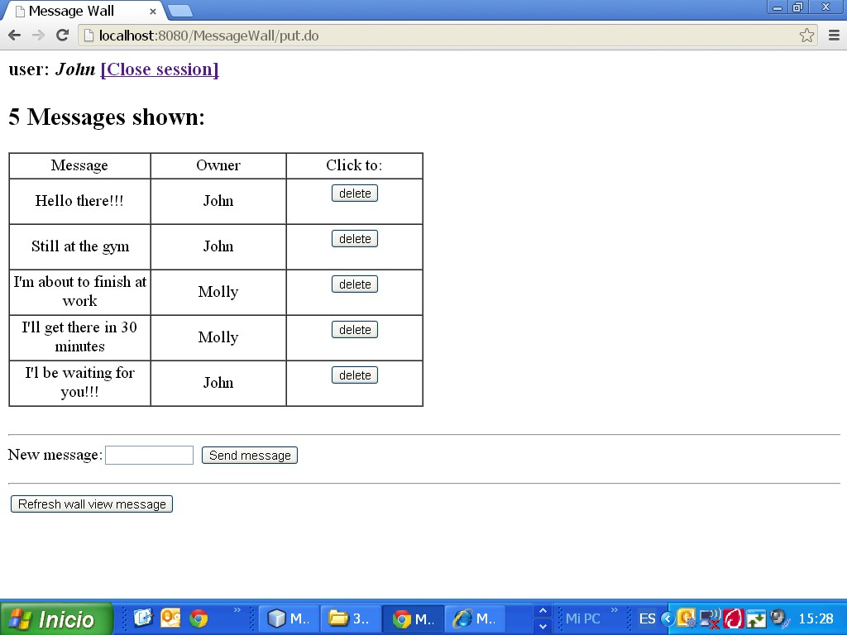
new Wall view

Slide 12
Exercise
Add the following JavaScript code for the wallview.jsp file to periodically request (polling strategy) for new messages on the wall, without having to press the refresh button (asynchronous performance):
<script>
setInterval(my_function, 10000); function my_function() {
document.getElementsByName('refresh_button')[0].click();
}
</script>

Slide 13












Getlast, if there is no message we have to introduce a initial message.

